Slide 1


Slide 2
贴Think
关注大学生心理健康发展，致力于学生心理问题研究的社区
团队成员：杨国超、黄慧敏、曾太
指导教师：周立章

Slide 3
贴Think
1.音译：贴心的贴，贴心的心。
2.意译：贴近你心，贴近你的Think（想法）。
关注大学生心理健康发展，致力于学生心理问题研究的社区

Slide 4
目
录
01
产品背景
02
功能描述
03
用户界面
04
技术分享

Slide 5
1 产品背景
情景引导
问题背景
描述产品产生的背景和起源。
问题分析

Slide 6


1 产品背景
情景引导
人生而自由，而又无不在枷锁之中
成长的过程总是伴随着可说与不可说的烦难，生活中总有一些事无足轻重却叫人难以接受的小事。大学生的普遍年龄一般在18—25岁之间，从心理学的观点来看，正处于青年中期。
大学生的心理具有青年中期的许多特点，但作为一个特殊群体，大学生又不能完全等同与社会上的青年。心理健康与不健康也并无明显界限，而是一个连续化的过程。 贴Think关注的就是这个过程，旨在引导大学生积极健康度过青年中期。

Slide 7
1 产品背景
问题分析
我不打算举例子说明大学生需要心理咨询
我猜你一定知道很多关于大学生心理出现问题的例子，对于大学生需不需要心理指导，引导，就好像小孩子要不要教他唱歌一样

Slide 8
那么，新的问题又出来了

Slide 9
1 产品背景
问题分析
中国人为什么不愿意去心理咨询？
1
心理咨询师培养问题
3
咨询误解普遍
目前中国大学的心理系几乎都不发展心理咨询方向，以心理咨询作为研究授课方向的老师很少。
很多人认为心理咨询跟一般的找个朋友聊聊天没有太大区别.而且咨询价格性价比不清晰
2
国内心理咨询行业
咨询人忧虑问题
4
国内心理咨询行业，鱼龙混杂。社会上对于心理咨询的接受程度不是很高
担心自己的身份暴露，被别人知道自己的秘密

Slide 10
看贴Think怎么完美解决这些问题
举个例子：用户选择匿名发表动态（保证用户的隐私）其他用户实名评价（用户是大学生，有共同性。实名表示减少喷子）。将有强烈共鸣的话题推送到心理管理中心给于专业指导（心理健康的正确引导）。通过潜移默化的教育，让大学生平安度过青少年时期。

Slide 11
1 功能描述
故事社区
心理社区
心理咨询室
描述产品产生的背景和起源。
心理测试
用户模块

Slide 12
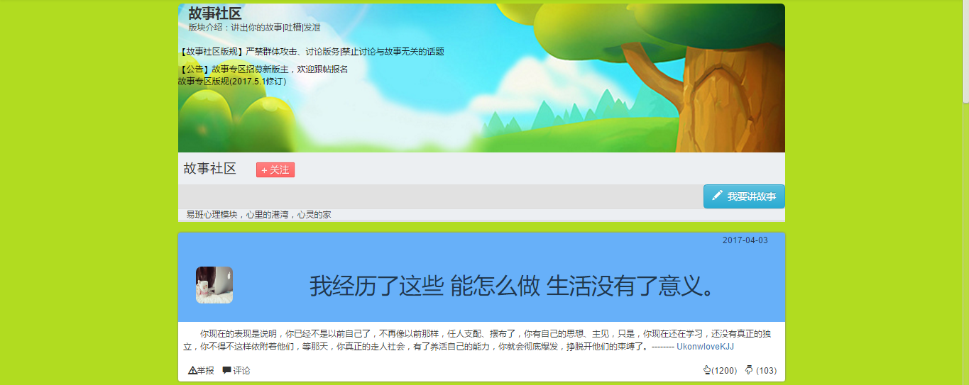
2 功能描述
故事社区
讲出你的故事，让大家与你同乐同悲。

Slide 13
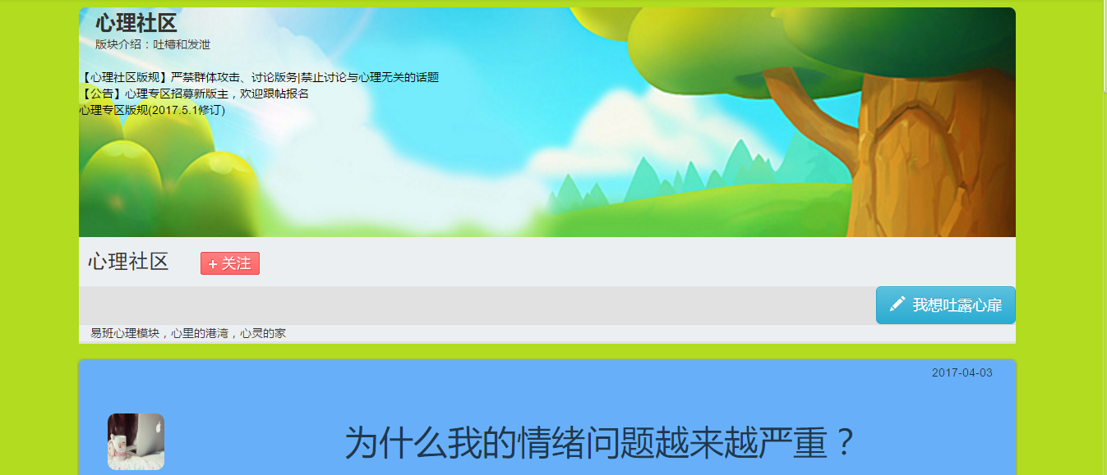
2 功能描述
心理社区
匿名说说心里话，实名为你解心结。

Slide 14
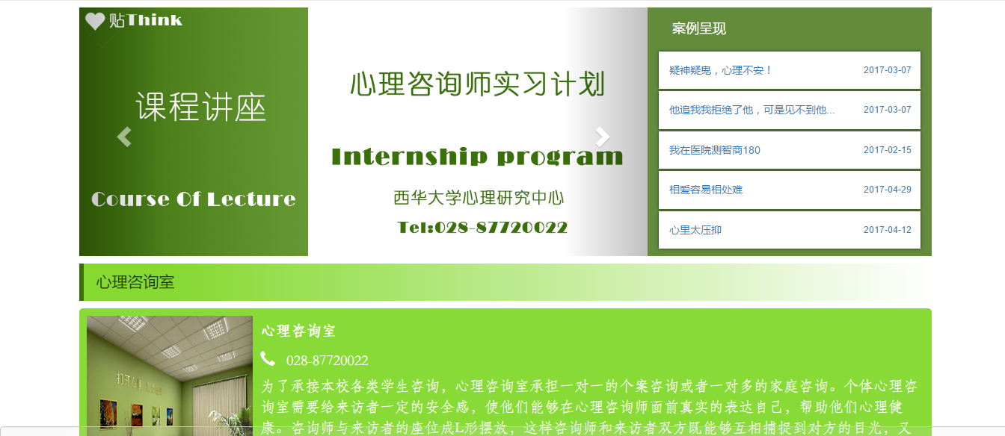
2 功能描述
心理咨询室
匿名咨询专家，解答您心里的每一个心症。

Slide 15
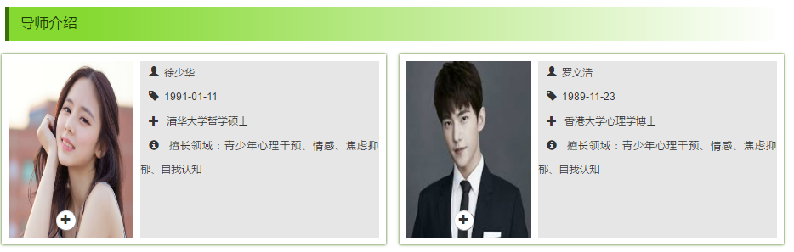
2 功能描述
心理咨询室
匿名咨询专家，解答您心里的每一个心症。

Slide 16

2 功能描述
更全面地了解自己实时测评，了解您每一种心理类型的健康状态
心理测试

Slide 17
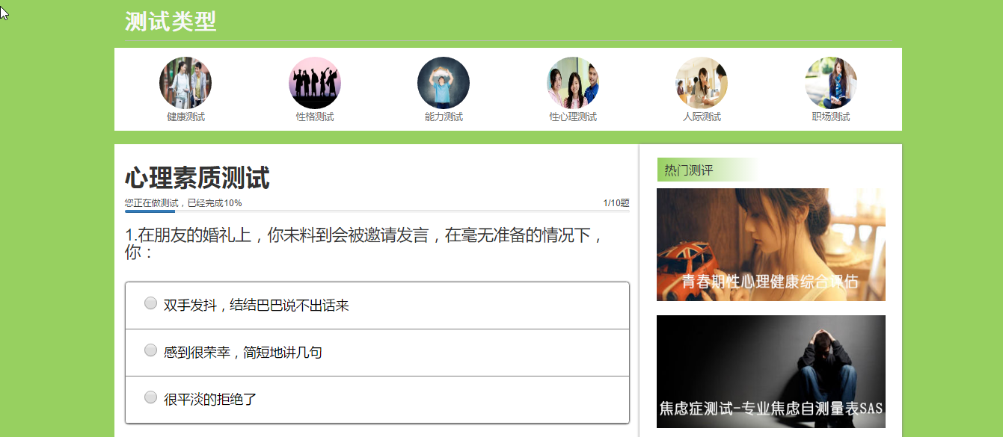
2 功能描述
实时测评，了解您每一种心理类型的健康状态
心理测试

Slide 18
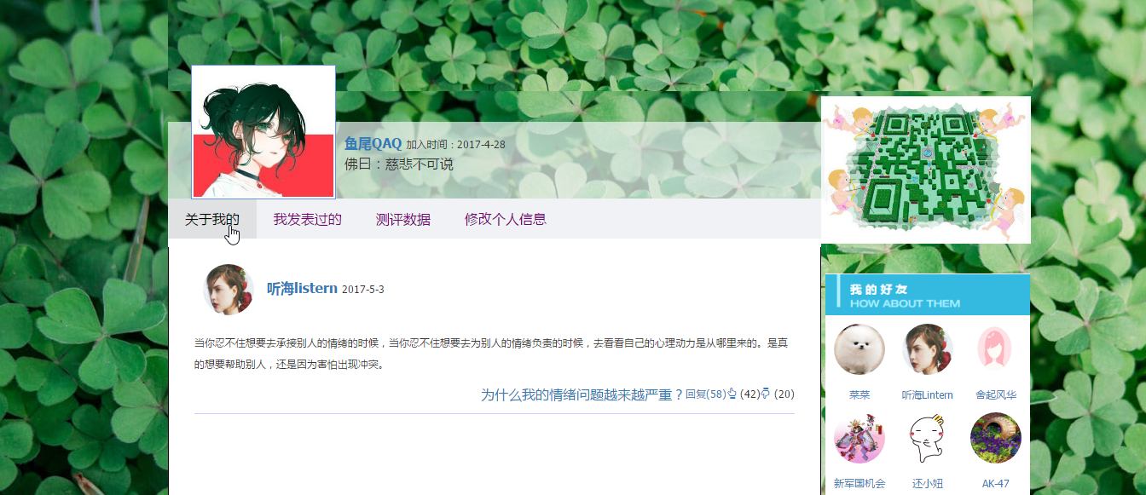
2 功能描述
用户模块
个人界面，看见自己，也让他人了解你

Slide 21
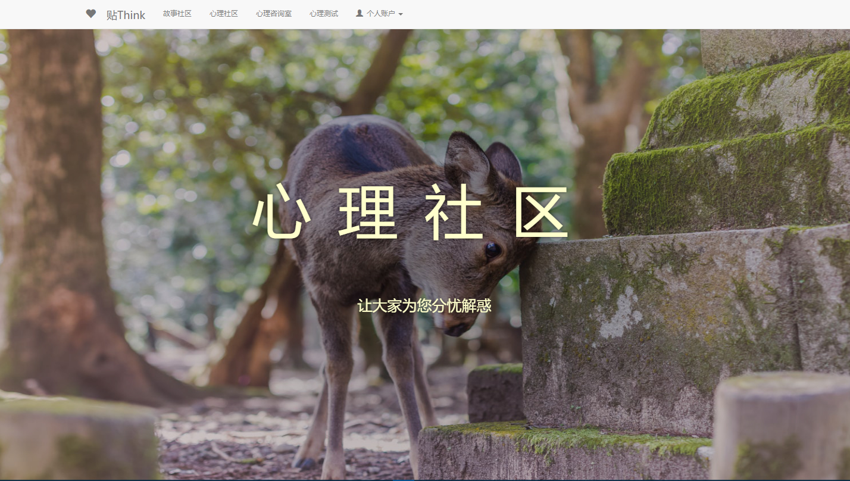

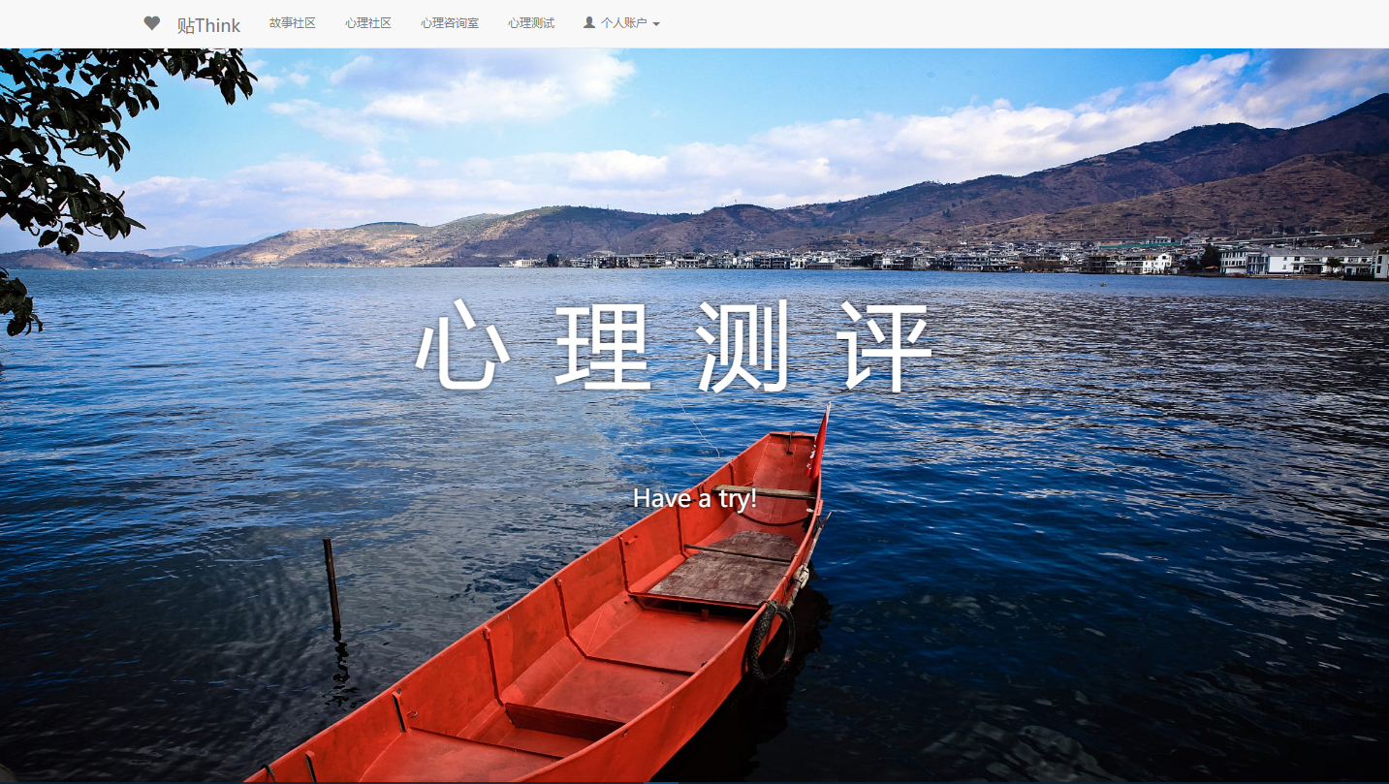

主页面采用全屏的图片方式
简介明了的风格让用户快速了解并选择自己需要方面。我们也做了导航栏，方便喜欢传统网站的用户

Slide 22



ADD YOUR TITTLE HERE
Just for today I will try to live through this day only and not tackle my whole life problem at once Just for today I will try to live. through this day only and not tackle my whole life problem at once Just for today I will try to live. through this day only and not tackle my whole life problem at once Just for today I will try to live. through this day only and not

Slide 23
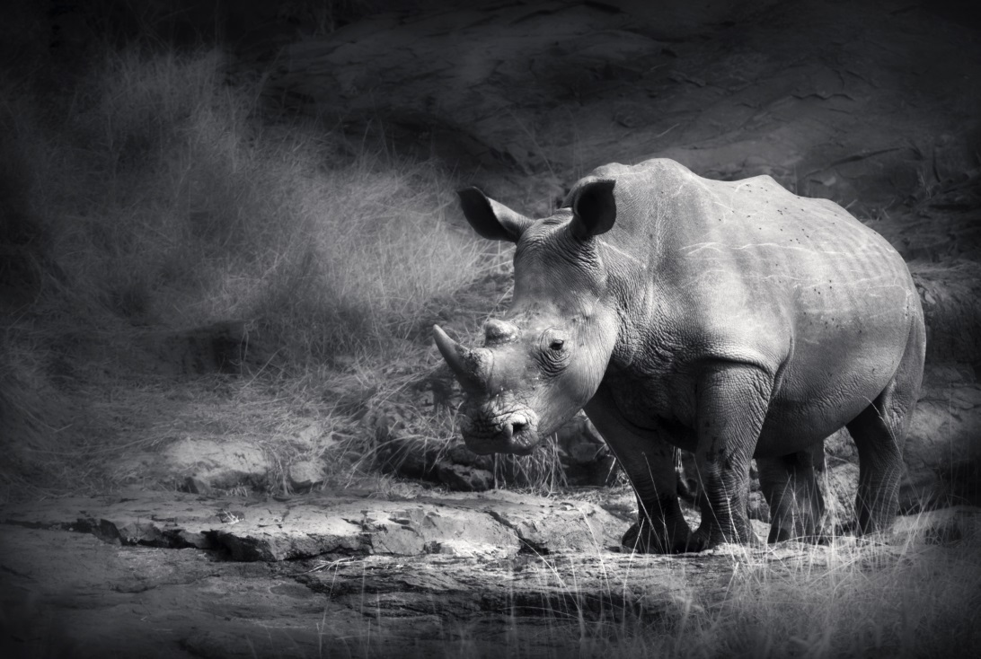
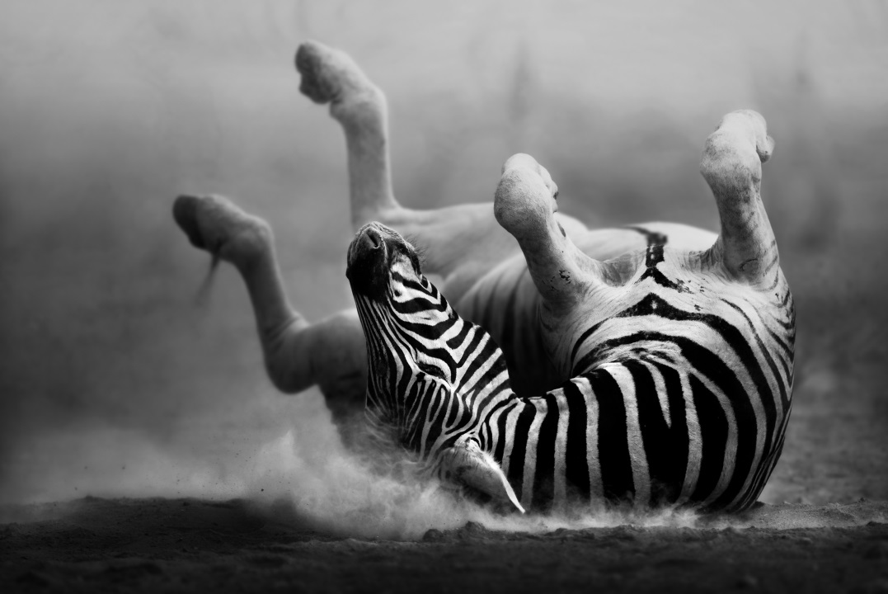
Just for today I will try to live through this day only and not tackle my whole life problem at once. I can do for twelve this day only and not tackle my whole life problem at once. I can do for twelve hours that

Slide 24

ADD YOUR TITTLE HERE
Just for today I will try to live through this day only and not tackle my whole life problem at once Just for today I will try to live. through this day only and not tackle my whole life problem at once Just for today I will try to live. through this day only and not tackle my whole life problem at once Just for today I will try to live. through this day only and not

Slide 25


ADD YOUR TITTLE HERE
Just for today I will try to live through this day only and not tackle my whole life problem at once Just for today I will try to live. through this day only and not tackle my whole life problem at once Just for today I will try to live.
ADD YOUR TITTLE HERE
Just for today I will try to live through this day only and not tackle my whole life problem at once Just for today I will try to live. through this day only and not tackle my whole life problem at once Just for today I will try to live.

Slide 26

ADD YOUR TITTLE
Just for today I will try to live this day only and not tackle my whole life problem at Just for today I will try to live this day only and not tackle my whole
ADD YOUR TITTLE
Just for today I will try to live this day only and not tackle my whole life problem at
ADD YOUR TITTLE
Just for today I will try to live this day only and not tackle my whole life problem at
ADD YOUR TITTLE
Just for today I will try to live this day only and not tackle my whole life problem at

Slide 27
12，000
10，000
20，000
TITTLE HERE
TITTLE HERE
TITTLE HERE
Just for today I will try to live through this day only and not tackle my whole life problem at once. I can do
Just for today I will try to live through this day only and not tackle my whole life problem at once. I can do
Just for today I will try to live through this day only and not tackle my whole life problem at once. I can do

Slide 28
03
ADD YOUR TITTLE
THIS IS A ART TEMPLATE ,THE TEMPLATE DESIGN BY JIUJIU. THANK YOU WATCHING THIS ONE. THIS IS A ART TEMPLATE

Slide 29

ADD YOUR TITTLE HERE
Just for today I will try to live through this day only and not tackle my whole life problem at once Just for today I will try to live. through this day only and not tackle my whole life problem at once Just for today I will try to live. through this day only and not tackle my whole life problem at once Just for today I will try to live. through this day only and not

Slide 30
ADD YOUR TITTLE HERE
Just for today I will try to live through this day only and not tackle my whole life problem at once Just for today I will try to live. through this day only and not tackle my whole life problem at once Just for today I will try to live. through this day only and not tackle my whole life problem at once Just for today I will try to live.

Slide 31

ADD YOUR TITTLE HERE
Just for today I will try to live through this day only and not tackle my whole life problem at once Just for today I will try to live. through this day only and not tackle my whole life problem at once Just for today I will try to live. through this day only and not tackle my whole life problem at once Just for today I will try to live. through this day only and not

Slide 32

ADD YOUR TITTLE HERE
Just for today I will try to live through this day only and not tackle my whole life problem at once. I can do for twelve this day only and not tackle my whole life problem at once. I can do for twelve hours that
TITTLE HERE
Just for today I will try to live through this day only and not tackle my whole life problem at once. I can do

Slide 33
04
ADD YOUR TITTLE
THIS IS A ART TEMPLATE ,THE TEMPLATE DESIGN BY JIUJIU. THANK YOU WATCHING THIS ONE. THIS IS A ART TEMPLATE

Slide 34
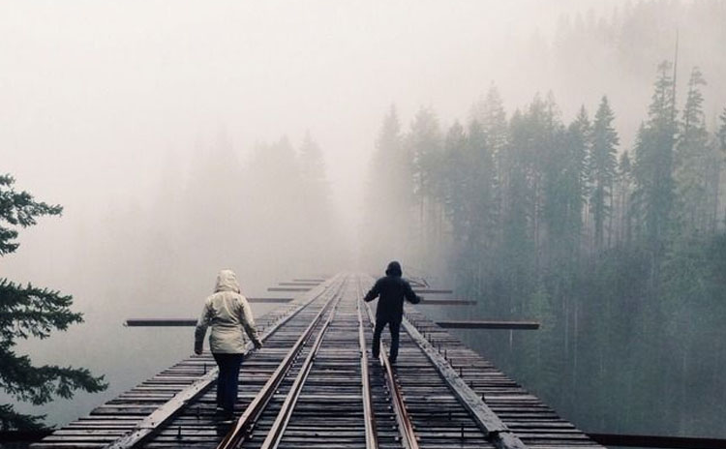
ADD YOUR TITTLE HERE
Just for today I will try to live through this day only and not tackle my whole life problem at once. I can do for twelve this day only and not tackle my whole life problem at once. I can do for twelve hours that
Just for today I will try to live through this day only and not tackle my whole life problem
Just for today I will try to live through this day only and not tackle my whole life problem

Slide 35

Just for today I will try to live through this day only and not tackle my whole life problem at once. I can do for twelve this day only and not tackle my whole life problem at once. I can do for twelve hours that
Just for today I will try to live through this day only and not tackle my whole life problem at once. I can do for twelve this day only and not tackle my whole life problem at once. I can do for twelve hours that

Slide 36
TITTLE HERE
0 1
Just for today I will try to live through this day only and not tackle my whole life problem at once
0 2
Just for today I will try to live through this day only and not tackle my whole life problem at once
0 3
Just for today I will try to live through this day only and not tackle my whole life problem at once
0 4
Just for today I will try to live through this day only and not tackle my whole life problem at once

Slide 37
hours that Just for today I will try to live through this day only and not tackle my whole life problem at once. I can do for twelve hours that not tackle my
hours that Just for today I will try to live through this day only and not tackle my whole life problem at once. I can do for twelve hours that not tackle my

Slide 38

ART TEMPLATE
THANK YOU
THIS IS A ART TEMPLATE ,THE TEMPLATE
DESIGN BY JIUJIU. THANK YOU WATCHING THIS ONE.

